Slide 1

Master Method
Recurrence Relation
If we had done the iterative substitution method, or the recursion tree method again and again… we might have started to see a pattern.

Slide 2

Analyzing Divide and Conquer Algorithms
recurrence equation (recurrence)
T(n) = running time
Base case:
General case: a subproblems of size n/b
D(n) = time to divide the problem into subproblems
C(n) = time to combine the solutions to the subproblems

Slide 3

Master Method
cases
if then
if then
if then
(cost dominated by the root)
(cost is same at each level)
(cost dominated by the leaves)

Slide 4

Master Method (simplified)
cases
if then
if then
if then
(cost dominated by the root)
(cost is same at each level)
(cost dominated by the leaves)

Slide 5




Iterative Method
Let
( )
Note that
and

Slide 6







Recursion Tree
}
#subproblems
size
non recursive cost
…
…
…
…
…
…
…
…
…
…
…
…
… ……………………………………..
…
…
…
…
…
…
…
Work for each level
Total work:
WLOG*
* if n is not a power of add extra dummy values
every node has children
Notes:
Instead of writing the non-recursive cost, you could label it as the cost of operating (dividing and combining) non leaf nodes.

Slide 7




case 1
If
then
Sum of the geometric series
(since then)
Thus
sum of geometric series with ratio less
than one

Slide 8
case 2
If
then
Thus

Slide 9





case 3
If
then
largest term is last one
Sum of the geometric series
(since then)
constant

Slide 11
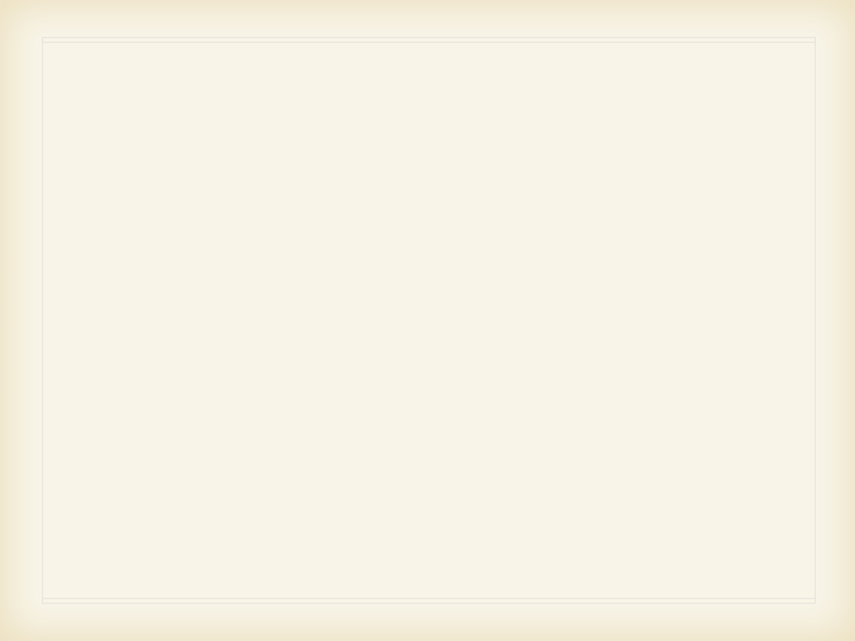
Reduce the original problem into subproblems that are easier to solve.
37
25
19
15
20
72
43

Slide 12
Solve the subproblems, and the combine to solve the original problem
19
15
37
25
20
43
72

Slide 13
The subproblems are solved recursively
20
15
72
25
43
37
19

Slide 14
QuickSort
43
37
25
19
4
72
15
20
SELECT PIVOT; PARTITION
19
4
15
20
37
72
25
43
<= pivot
pivot
>= pivot
SORT EACH PIECE (Recursively)
4
15
19
20
25
37
43
72
done!

Slide 15
QUICKSORT(A, 1, n)
QUICKSORT(A, p, r)
if p < r q = PARTITION(A,p, r)
QUICKSORT(A, p, q - 1)
QUICKSORT(A, q +1, r)
PARTITION(A, p, r)
x = A[r]
i = p - 1 for j = p to r -1
if A[j ] ≤ x
i = i +1
exchange A[i ] with A[j]
exchange A[i + 1] with A[r]
return i + 1
A[i..p] ≤ A[r], A[i+1..j-1] > A[r]
43
37
25
19
4
72
15
20

Slide 16
1 2 3 4 5 6 7 8
A
43 | 37 | 25 | 19 | 4 | 72 | 15 | 20

Slide 17



Best Case: 50/50 Split!
...
...

Slide 18

Suppose: 90/10 Split...
...
...
...
...
...
...
...

Slide 19


Worst Case: n-1/0 Split...
...

Slide 20
How to (probably) avoid the bad case in QuickSort
Randomization!
Assume any input - not just the “average” input
Chose a random pivot
RANDOMIZED-PARTITION(A,p,r)
i = RANDOM(p,r)
exchange A[r] with A[i]
return PARTITION(A, p, r)

Slide 21
Now, there is no worst case input. A sorted array will work just as fast as an array filled with randomly chosen elements!
Randomization!
QUICKSORT(A, p, r)
if p < r q = RANDOMIZED-PARTITION(A,p, r)
QUICKSORT(A, p, q - 1)
QUICKSORT(A, q +1, r)

Slide 22
Now, there is no worst case input. A sorted array will work just as fast as an array filled with randomly chosen elements!
But….
Worst Case Analysis

Slide 23
Indicator Random Variable
Observation
Proof:

Slide 24


We add randomness to the algorithm. Randomness is not assumed for the data
Average Case Analysis
All the elements from zi to zj
Observe that any two elements will be compared at most one time
Linearity of expectation!

Slide 25


Average Case Analysis

Slide 26






randomness occurs in the algorithm. Randomness is not assumed for the data
Average Case Analysis
Observe that any two elements will be compared at most one time
Homework assignment
Renaming

Slide 27

i^{th} Order Statistic
We can solve this problem in
n*log(n) time!
Just sort the items fist.
Input: A (n distinct numbers), i (1 ≤ i ≤ n)
Output: x such that (n distinct numbers), i (1 ≤ i ≤ n)
such that i-1 numbers in A are smaller than x
minimum (i = 1)
maximum (i = n)
median (i = ⎣(n+1)/2)⎦

Slide 28
a graphics program
Can we find the min/max faster?
MINIMUM(A, n)
min =A[1]
for i = 2 to n
if min > A[i]
min = A[i]
return min
MAXIMUM(A, n)
max =A[1]
for i = 2 to n
if max < A[i]
max = A[i]
return max

Slide 29
Can we do this faster?

Slide 30
Compare A[2i] with A[2i+1]
The larger is compared with max
the smaller with min
For analysis - assume n is even.
The case when n is odd is similar

Slide 31
i^{th} Order Statistic
QUICKSORT(A, p, r)
if p < r q = RANDOMIZED-PARTITION(A, p, r)
RANDOMIZED-SELECT(A,p,r, i)
k = q - p + 1
QUICKSORT(A, p, q - 1)
if k == i
return A[q]
elseif i < k
QUICKSORT(A, q +1, r)
return RANDOMIZED-SELECT(A, r, q-1, i)
else
return RANDOMIZED-SELECT(A,q+1,r, i-k)

Slide 32
Worst Case: n-1/0 Split...
...

Slide 33
Best Case:
...

Slide 34
OK Case
...

Slide 35






Average Case Analysis

Slide 36
Can we do this better?

Slide 37

Deterministic Linear Selection!
…

Slide 38

Recursively call SELECT
Find the middle of the middle elements
…

Slide 39
The recursion returns one item
…
…
This is the middle of the middle elements

Slide 40

Time to find the middle of the middle elements
Analysis
Time to find the i^{th} largest, after the partition
if a group has less than 5 items, and
the group containing x
in the worst case
?
?

Slide 41

Analysis Cont.
choose a constant, a, such that the function for the O(n) term is at most a*n for n>0
?
?

Slide 42
Data often represented abstractly
Graphs
Graphs show the relationship between objects/events

Slide 43
routes for mass transit
7th Ave
Rockefeller Ctr
50th Street
Penn Station
Bryant Park
Times Sqr
23rd Street
6th Street
14th Street
4th Street
Chambers Street
Broadway-Nassau

Slide 44
Flight Paths
Tokyo
Los Angeles
Shanghai
Hong Kong
Rarotonga
Sydney
Auckland
Los Angeles

Slide 45
Many applications
Communications:
Nodes : computers
Edges: direct connections between computers
Transportation:
Nodes: cities
Edges: roads, air routes, train tracks, etc.
Social
Nodes: people
Edges: friendships, common interests, etc.

Slide 46

sometimes the vertex are labeled
i.e. assigned a unique identifier
Graph
Tokyo
Shanghai
Los Angeles
G = (V,E)
V is a set of nodes/vertices
E is a set of pairs of vertices, called edges
Example:
A vertex represent an airport
V = {Shanghai, Tokyo, Los Angeles, Hong Kong, Sydney, Auckland, Rarotonga}
An edge represents a flight route between two airports
E = {(Shanghai, Tokyo), (Shanghai, Hong Kong), (Shanghai, Sydney),
(Tokyo, Hong Kong), (Tokyo, Syndey), (Tokyo, Los Angeles),
(Hong Kong, Sydney), (Sydney, Auckland), (AuckLand, Rarotonga)}
Rarotonga
Hong Kong
Sydney
Auckland
|V| =
7
|E| =
9

Slide 47
Edge Types
Undirected
unordered pair of nodes/vertices (u,v)
(u,v) is the same as (v,u)
Directed
ordered pair of nodes/vertices (u,v)
(u,v) ≠(v,u)
first vertex, u, is source/origin, second vertex, v, is destination
Weighted or Unweighted
in a weighted graph, every edge (or vertex) has a weight. Weight function w: E→ℝ
in an unweighted graph, there is no weight value to a edge (or vertex)
Undirected Graph: all edges are undirected
Directed Graph: all edges are directed
Shanghai
2
Tokyo
Tokyo
Los Angeles
9
Los Angeles
Shanghai
5
3
4
7
9
Rarotonga
Auckland
Auckland
Rarotonga
8
1
1
Hong Kong
Hong Kong
Sydney
Sydney
Tokyo is adjacent to Shanghai
Tokyo is adjacent to Shanghai
Shanghai is adjacent to Tokyo
Shanghai is NOT adjacent to Tokyo
A path: Los Angeles,Tokyo, Shanghai, Sydney, Auckland
A path: Los Angeles,Tokyo, Shanghai, Sydney, Auckland

Slide 48
Terminology: Undirected Graph
These definitions are found in section B.4
2
a
c
f
degree
of a vertex
3
b
e
h
reachable?
d
path
h,j,g,i,j,m
g
0
j
m
subpath
g,i,j
simple path
f,c,a,b,e
i
cycle
k
simple cycle
g,i,j,g
l
isolated
connected
no
connected component

Slide 49
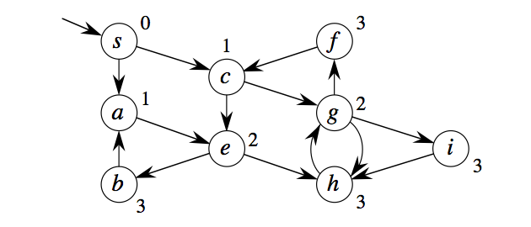
Terminology: Directed Graph
degree
of a vertex
2
5
strongly connected
no
strongly connected component
acyclic
DAG

Slide 50
Adjacency Matrix Representation
Tokyo
Los Angeles
Implementation?
Shanghai
Hong Kong
Rarotonga
Sydney
Auckland
Adjacency Matrix:
Hong Kong
Los Angeles
Shanghai
Auckland
Rarotonga
Sydney
Tokyo
Shanghai
 | X | X | X
X |  | X | X
X | X |  | X | X | X
X | X | X |  |  | X
 |  | X |  |  |  | X
 |  | X | X
 |  |  |  | X
Hong Kong
Sydney
Tokyo
Auckland
Los Angeles
Rarotonga

Slide 51

Adjacency Matrix Representation
Tokyo
Los Angeles
Implementation?
Shanghai
2
9
5
3
4
7
9
Hong Kong
8
1
1
Rarotonga
Sydney
Auckland
Adjacency Matrix:
Hong Kong
Los Angeles
Shanghai
Auckland
Rarotonga
Sydney
Tokyo
Shanghai
 | 3 | 5 | 2
3 |  | 8 | 4
5 | 8 |  | 7 | 1 | 9
2 | 4 | 7 |  |  | 9
 |  | 1 |  |  |  | 1
 |  | 9 | 9
 |  |  |  | 1
Hong Kong
Sydney
Tokyo
Auckland
Los Angeles
Rarotonga

Slide 52
Adjacency List Representation
1
3
4
2
1
3
2
2
1
3
3
1
4
2
4
3
Table in position j contains list of vertices adjacent to vertex j,

Slide 53
Which to Choose?
space
computational efficiency
flexibility
Adjacency Structure:
O(V + E)
2
Adjacency Matrix:
O(V )
Adjacency Structure:
Adjacency Matrix:
Easy to determine if an edge is in the graph O(1) time
Simple - so when only a few nodes - easy to use
When not storing weights, only one bit needed per entry
Adjacency Structure:
Cumbersome to vary the edges incident with a vertex
Adjacency Matrix:
Easy to vary the edges incident with a vertex

Slide 54

Shortest Path
Input:
Directed Graph G=(V,E)
Weight function w: E→ℝ
Weight of path = v0, v1, v2,…, vn
k
= ∑w(vi-1, vi)
i=1
= sum of weights on path
Shortest path weight u, v

Slide 55
Details….
single source?
from s ∈ V to every other v ∈ V
single destination?
from every v ∈ V to s ∈ V
every pair?
from every v∈V to u∈V
(we don’t know a better way than solving the single-source all pairs.)
negative weights?

Slide 56
Traversal of a Graph
A basic graph problem is to traverse the graph.
i.e. visit every edge and vertex in the graph.
Goals of an algorithm that traverses the graph
visit every edge only one time - efficiency
traverse systematically - correctness
example: traversing a maze - could we make sure we wouldn’t get stuck

Slide 57
Traversal
1
3
4
2
A traversal of a graph is an ordered visiting of all the vertex in the graph.
Example: G=(V,E) can be traversed by 1,2,3,4
Note that in traversing a tree, you construct a predecessor subgraph, (or a spanning tree)
The predecessor subgraph forms a forest.

Slide 58
Use a ball and string?
To not get lost - we can mark each vertex.
http://en.wikipedia.org/wiki/File:Maze_Type_Standard.png

Slide 59
Level-Order Traversal of a Tree
BFS(V, E, s)
for each u ∈V - {s}
u.d =∞
s.d = 0
Q = ∅
ENQUEUE(Q, s)
while Q ≠ ∅ u = DEQUEUE(Q)
for each v ∈G.Adj[u] if v.d == ∞ v.d = u.d +1 ENQUEUE(Q, v)
a
b
e
c
d
f
g
a, b, e, c, d, f, g

Slide 60
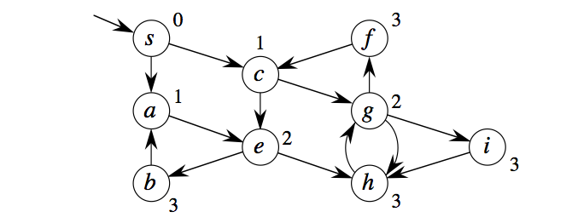
Breath First Search
1
3
4
2
BFS(V, E, s)
for each u ∈V - {s}
u.d =∞
s.d = 0
Q = ∅ ENQUEUE(Q, s)
while Q ≠ ∅ u = DEQUEUE(Q)
for each v ∈G.Adj[u] if v.d == ∞ v.d = u.d +1 ENQUEUE(Q, v)
Running Time?
Notes:
Breadth in place of breath

